Slide 1
Bright Byte Lights!
Python with Robots Mission 3
Lesson 2 Objective 6

Slide 2

Pre-Mission Warm-Up
In your Mission 3 Lesson 2 log, answer the first pre-mission warm-up question:
How many ways can you represent the value 7?

Slide 3
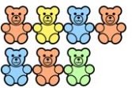





Representing the value 7
VII
10 - 3
seven

Slide 4
Pre-Mission Warm-Up
In your Mission 3 Lesson 2 log, answer the second pre-mission warm-up question:
How can a computer represent 7?

Slide 5
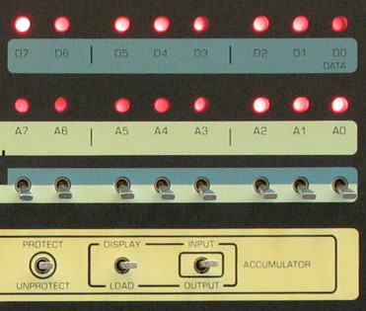
Mission 3: Bright Byte Lights!
Check out the picture. It’s from the front panel of one of the first personal computers.
Do you see the two rows of 8 DATA LEDs?
Each LED represents a single on/off switch, or binary digit – a bit.

Slide 6
Objective #6: Bright Byte Lights!
Our computers have come a long way since then!
CodeBot’s CPU is powerful compared to the old machines.
But just like ancient computers, laptops and cell phones today use binary.

Slide 7
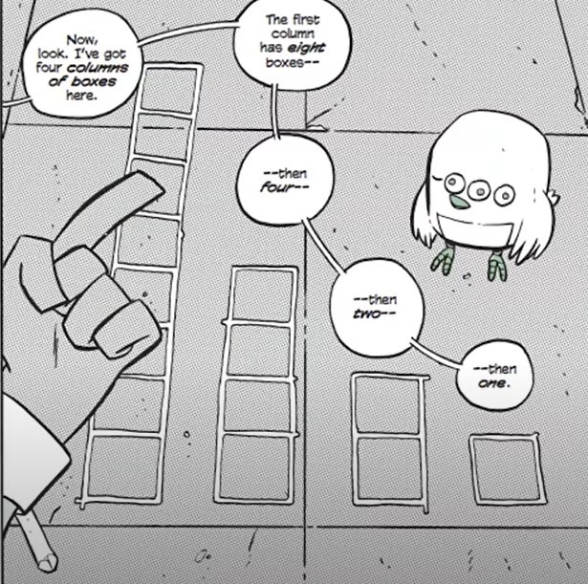

Binary Numbers
How do binary numbers work?
Watch the video for a short demonstration.
  Secret Coders video
  (start at 1:09 to 7:32)
Notes:
Youtube link: https://www.youtube.com/watch?v=bva4N7hNrNs

Slide 8
Mission 3 Lesson 2 Activity #1
DO THIS:
Complete Activity #1 on your mission log.
Convert decimal numbers to binary using the chart.
Convert binary numbers to decimal by using the chart.
Compare your answers with other students.

Slide 9

Binary Numbers
The chart only allows you to convert numbers up to 15.
What if you have larger numbers?
What would the next columns look like?
Look for the pattern!

Slide 10
Binary Numbers
Each column doubles the one before.
The next column to the left will have 16 boxes!
Then 32 boxes
Then 64 boxes
These are powers of 2!
  Start with 1 box
  2 x 1 = 2
  2 x 2 x 1 = 4
  2 x 2 x 2 x 1 = 8
  2 x 2 x 2 x 2 x 1 = 16
  2 x 2 x 2 x 2 x 2 x 1 = 32

Slide 11
Binary Numbers
Instead of using boxes, you can make a chart of the number of boxes for each column.
Each column represents one binary digit – a bit.
A group of 8 bits is called a byte.
1 bit
128 | 64 | 32 | 16 | 8 | 4 | 2 | 1
1 byte

Slide 12
Binary Numbers
You can use the chart to convert between binary and decimal numbers. A full column is 1 and an empty column is 0.
Convert from binary to decimal
128 | 64 | 32 | 16 | 8 | 4 | 2 | 1
0000 1101 | 8 + 4 + 1 | 13
0010 0010 | 32 + 2 | 34
0100 0101 | 64 + 4 + 1 | 69

Slide 13
Binary Numbers
You can use the chart to convert between binary and decimal numbers:
Convert from decimal to binary
128 | 64 | 32 | 16 | 8 | 4 | 2 | 1
17 | 16 + 1 | 0001 0001
30 | 32 + 2 | 0010 0010
55 | 32 + 16 + 4 + 2 + 1 | 0011 0111

Slide 14
Mission 3 Lesson 2 Activity #2
DO THIS:
Complete Activity #2 on your mission log.
Convert decimal numbers to binary using the chart.
Convert binary numbers to decimal by using the chart.
Compare your answers with other students.

Slide 15
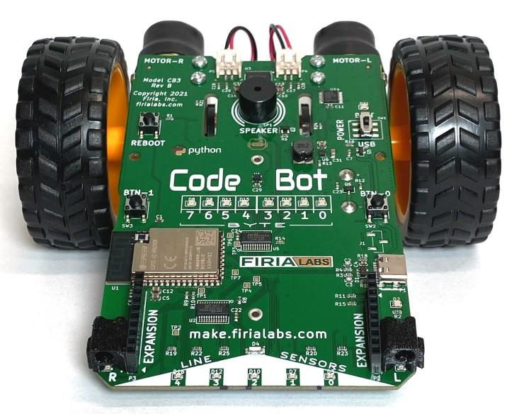
Binary Numbers
That is a lot of work.
Computers are great at doing math.
Let CodeBot do the work for you!
CodeBot can show a binary number using its LEDs.

Slide 16

Mission 3 Lesson 2 Activity #3
DO THIS:
Go to Mission 3 Objective 6 in CodeSpace.
Open the Console Panel.
Type this code:

Slide 17
Mission 3 Lesson 2 Activity #3
DO THIS:
Notice the LEDs that light up on CodeBot.
Compare them with your answer to
Activity #1 A
Does your binary answer match the LEDs?

Slide 18
Mission 3 Lesson 2 Activity #3
DO THIS:
Check your answers for B and C.
Type this code and observe the LEDs.
And then

Slide 19
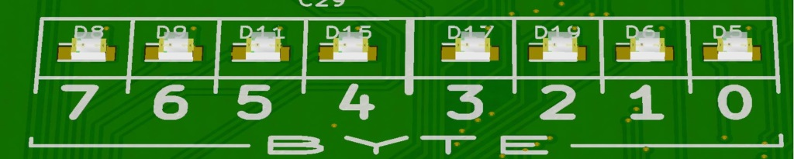
Binary Numbers
CodeBot can easily convert a decimal number to binary.
CodeBot can only count to 8 if it uses each LED as a separate counter.
But using binary, the 8 user LEDs can count up to 255!

Slide 20
Binary Numbers
You can use binary and the leds.user() function to turn on LEDs, without having to do any conversions.
  Use the prefix 0b to indicate a binary number
  leds.user(0b00110001)

Slide 21
Mission 3 Lesson 2 Activity #3
DO THIS:
Type this code in the Console Panel:
Observe the LEDs that turn on.
Try three more combinations of turning on/off user LEDs.
Record your code in the mission log.

Slide 22
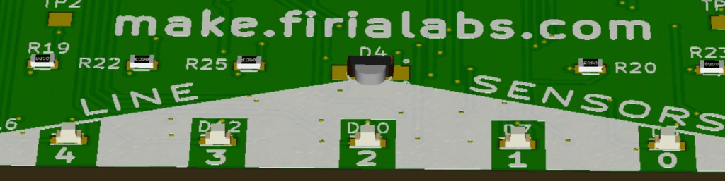
Binary Numbers
The line sensor LEDs can also be turned on/off with binary.
Use the function: leds.ls()
Use the prefix: 0b
There are five line sensors, so use five bits in the code.
This function call turns on all five line sensor LEDs:
  leds.ls(0b11111)

Slide 23
Objective #6 Activity
DO THIS:
Start a new file called BinaryLEDs.
Write code to control the line sensor LEDs using binary numbers. Sleep between each pattern.
  Light the middle ls LED
  Light the three middle ls LEDs
  Light all five ls LEDs
Try doing this on your own before checking CodeTrek.

Slide 24
Extension
Here are some things:
Add your own ls LED patterns to the program.
Add user LED patterns to the program.
Use a variable for the amount of delay in sleep().
Create a light show using binary, user LEDs and ls LEDs.

Slide 25

Mission quiz
Now …. time for a quiz!
Answer the five quiz questions in CodeSpace.
CODEX
QUIZ

Slide 26
Real-world Application
Computers can represent all types of information using numbers.
Letters and characters can be mapped to a number.
Colors can be represented with numbers.
Video and sound can also be represented with numbers.
The numbers are converted to binary!
Notes:
0001 1011 = 27 0010 0111 = 39 0110 0110 = 102
0001 1100 = 28 0010 1010 = 42 1011 0111 = 183
17 = 0001 0001 100 = 0110 0100 75 = 0100 1011
25 = 0001 1001 200 = 1100 1000 215 = 1101 0111

Slide 27
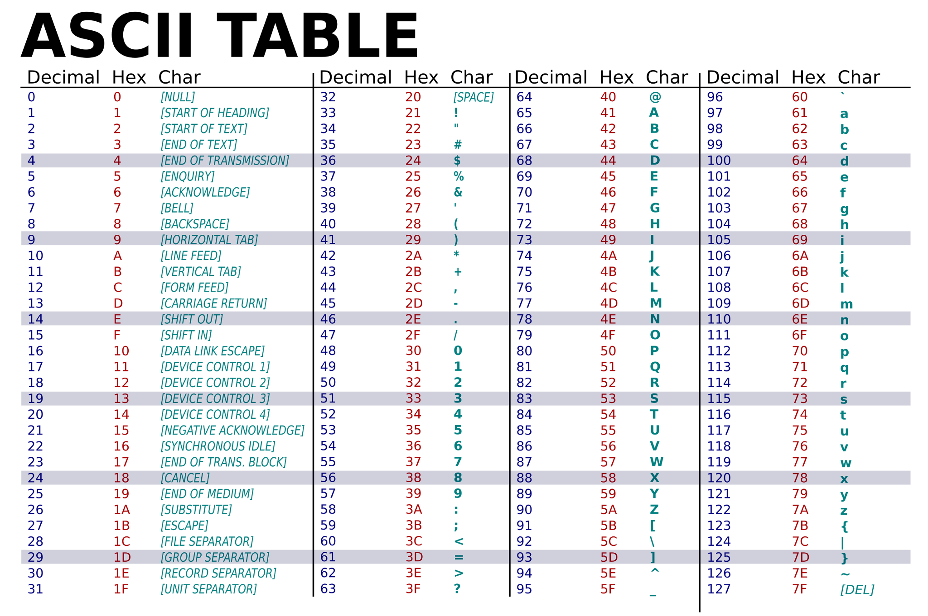

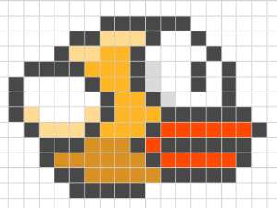
Real-world Application
Here are some examples:
Notes:
0001 1011 = 27 0010 0111 = 39 0110 0110 = 102
0001 1100 = 28 0010 1010 = 42 1011 0111 = 183
17 = 0001 0001 100 = 0110 0100 75 = 0100 1011
25 = 0001 1001 200 = 1100 1000 215 = 1101 0111

Slide 28
Post-Mission Reflection
Complete the post-mission reflection in your Mission 3 Lesson 2 Log

